Slide 1
SI 201 Discussion 3:
The Terminal, Git, and Rectangles

Slide 2
The Terminal

Slide 3
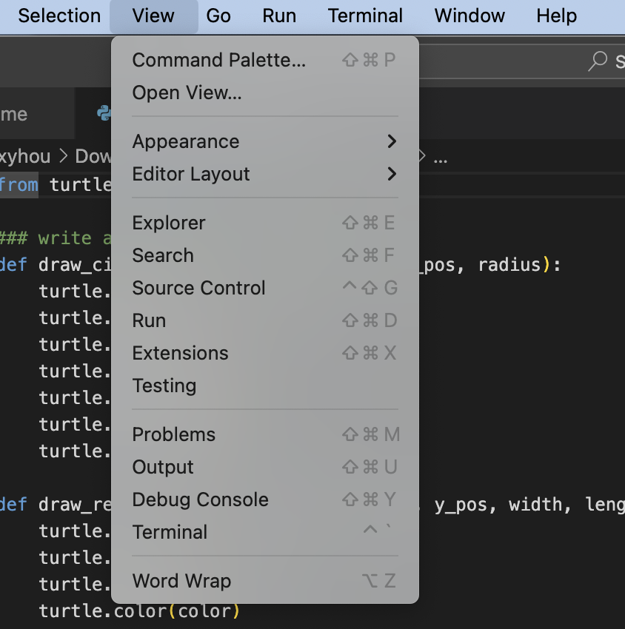
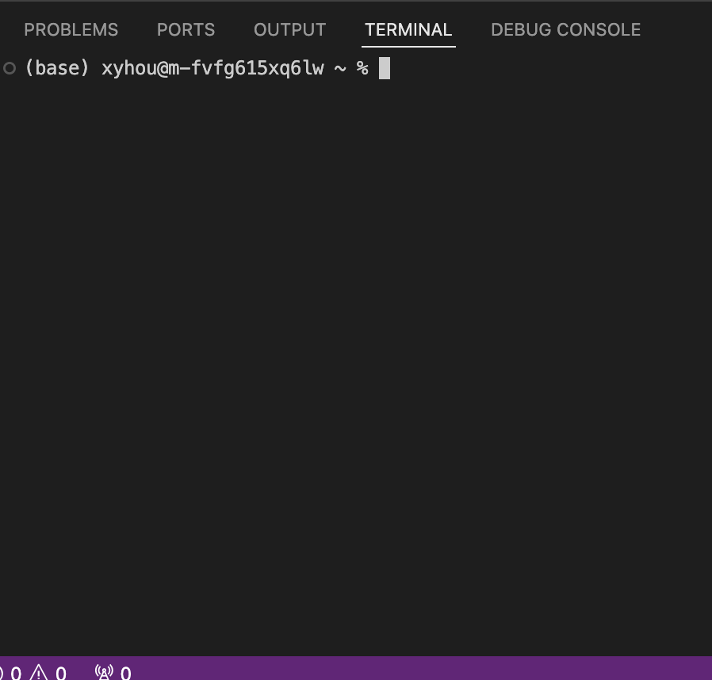
The Terminal - Command Line Interface (CLI)
VS Code Integrated Terminal

Slide 4
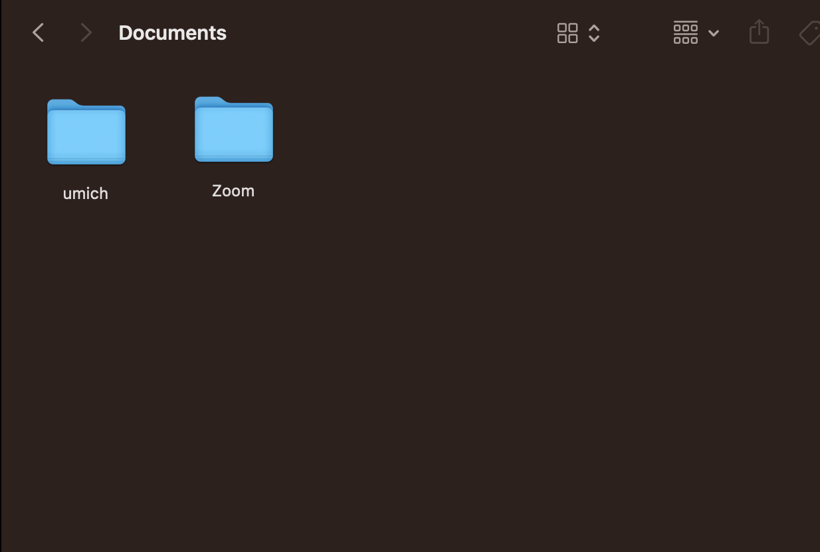
The Terminal - Graphical User interface (GUI)

Slide 5
Git & Github

Slide 6
Typical Git Flow - will need it for future assignments
git clone <link>
git add <file(s) you are modifying>
make your changes
git commit -m “<message>”
git push
use git status before, after, and throughout to keep track

Slide 7
Time to Practice!

Slide 8
Practice
Object oriented programing
  Create a rectangle class and methods to calculate the area and compare two rectangles.
  Create the rectangle instances, and call the methods
2. Git : Commit code after each method and push to GitHub in the end
  Please commit at least 4 times while working on your project; you might commit each time you finish writing a new function or method.

Slide 9
Discussion 3 Assignment
Accept the github classroom assignment and clone the repo
https://classroom.github.com/a/XsM1x4Qd
If you are having issues:
Canvas Files -> Discussions ->
Discussion 3 -> Discussion3.py

Slide 10
Rectangle class
Problem 1. Create the constructor "__init__" method
with arguments width (an integer), height (an integer)
It sets an instance variable, "width" to the passed argument, width
It sets an instance variable, "height" to the passed argument, height
Problem 2. Create the "__str__" method
It returns a string, "A rectangle with width <width> and height <height>"
for example, "A rectangle with width 3 and height 6"

Slide 11
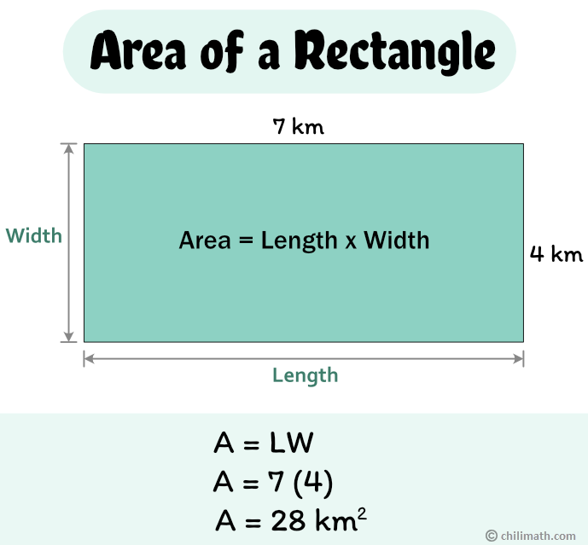
Rectangle class
Problem 3. Create the "area_calculator" method
It returns the area of the rectangle (float)
Area of rectangle = length × width.
Problem 4. Create the "__eq__" method with two arguments: self and other (an object)
It returns a boolean
True if the two rectangles have the same width
and the same height
False otherwise

Slide 12
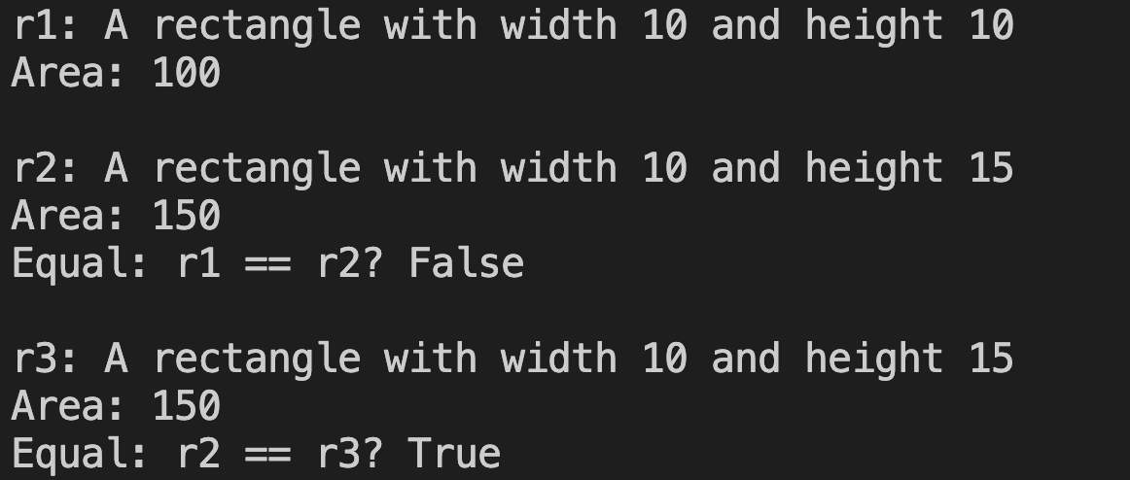
Sample output

Slide 13
Additional Tips about Git & Terminal

Slide 14
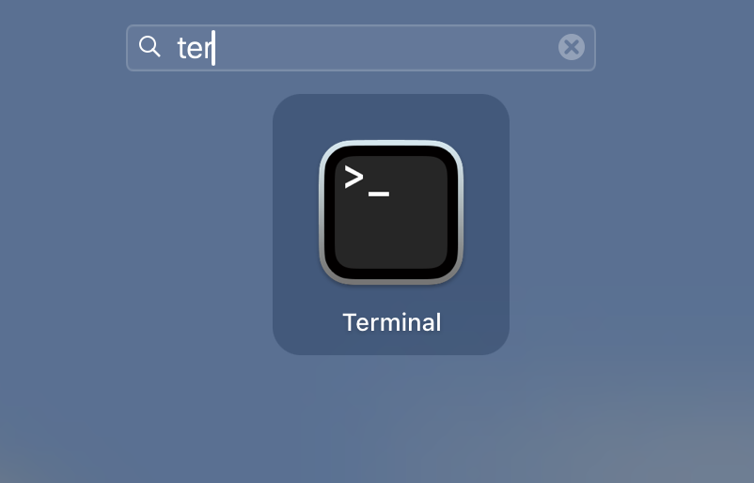
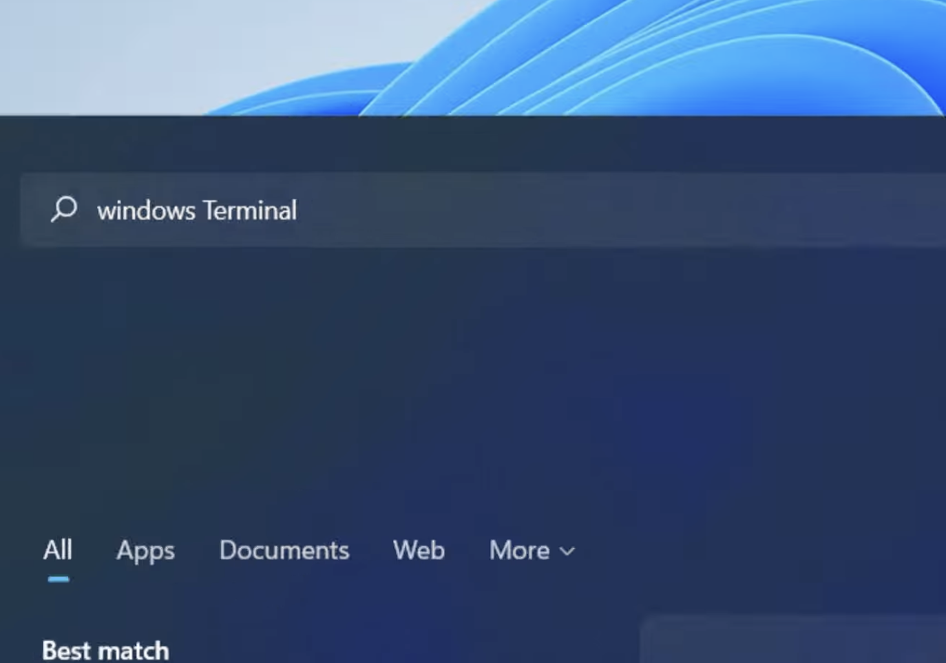
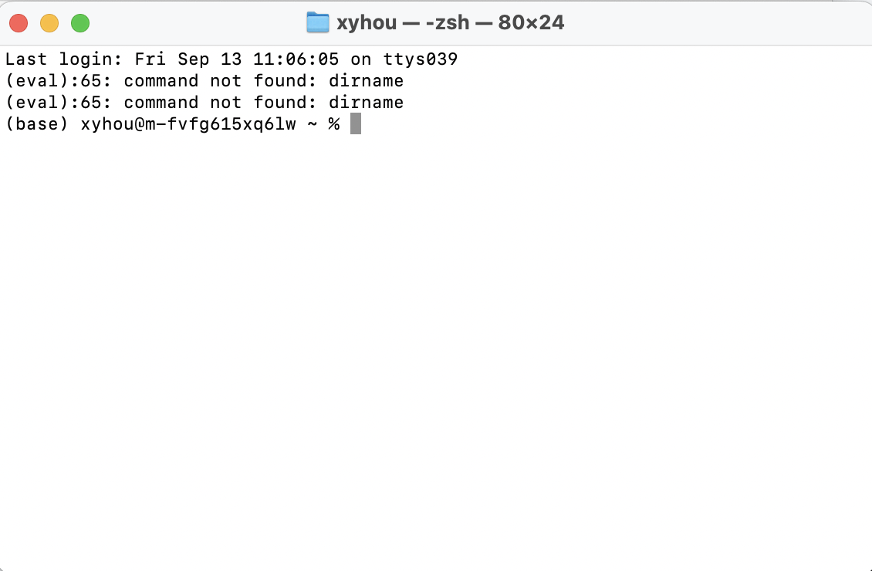
The Terminal - Command Line Interface (CLI)
Laptop Terminal

Slide 15
Basic Commands - Try it on your terminal!
GUI | CLI Command | Example
* current folder | pwd | pwd
* display folder content | ls | ls
navigate/ change location | cd | cd SI201
make a new folder | mkdir | mkdir my_new_folder

Slide 16


Paths
Special Characters:
current directory = .
parent directory = ..
home directory = ~
root directory = /
cd takes a path as an argument of which there are two kinds:
users
Relative path
If you are in "SI201"
cd week3
If you are in "Matty"
cd Documents/SI201/week3
If you are in “week2”
cd ../week3
Absolute path
Path from root directory
cd /users/Matty/Documents/SI201/week3
Path from home directory
cd ~/Documents/SI201/week3
Matty
Documents
SI201
week1
week2
week3
HW3_starter.py

Slide 17
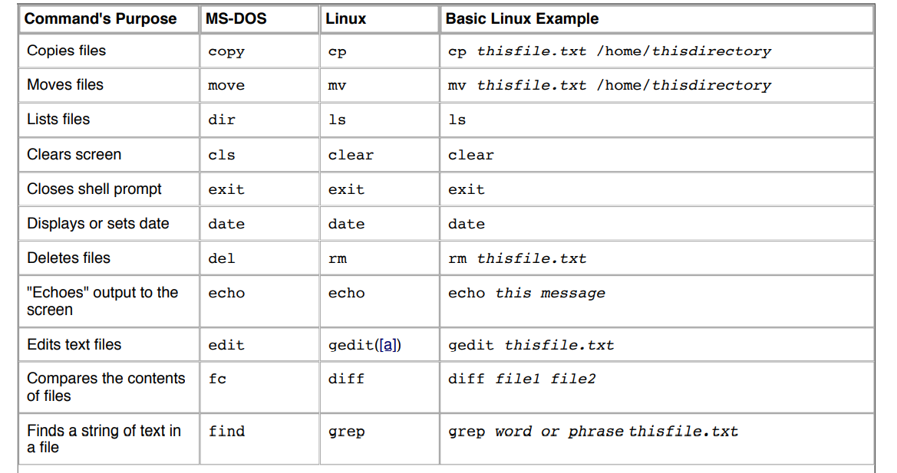

Slide 18
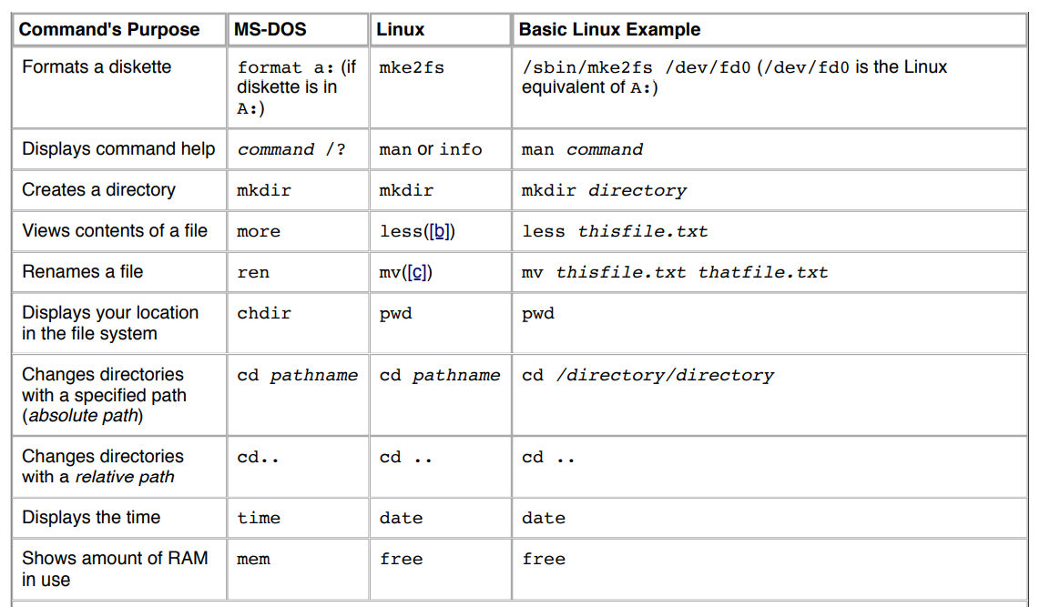

Slide 19
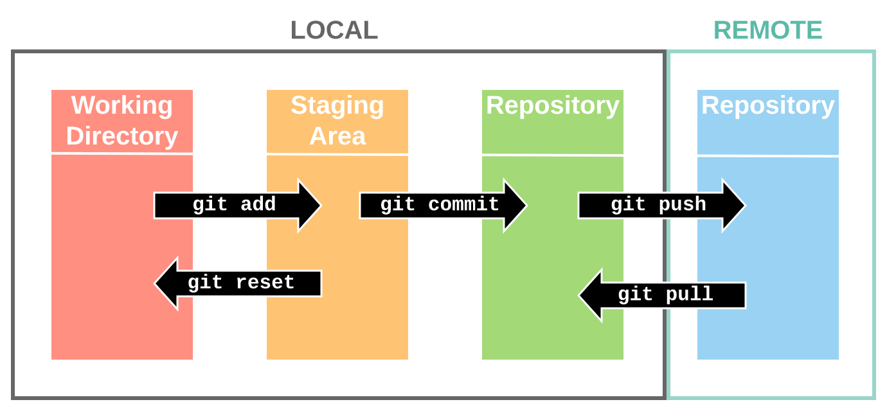
git clone

